Slide 1
Social Engineering Experiment
By: Chris Kerr, Kent Vasko, and Andrew Winfield

Slide 2
Objective
Obtain Passwords using social engineering.
How?
  Mass email to reach entire campus
  Email addresses easily copied and pasted from campus directory
  Scare tactic involving a fictional virus used to induce minor panic and stall critical thinking
  Posing as a fictional computer help center to gain trust

Slide 3
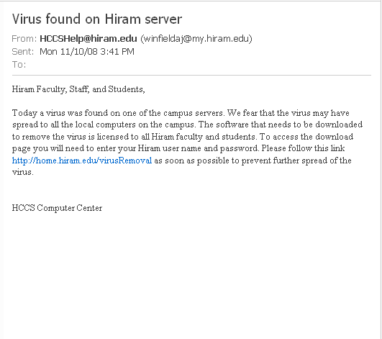

The Bait

Slide 4
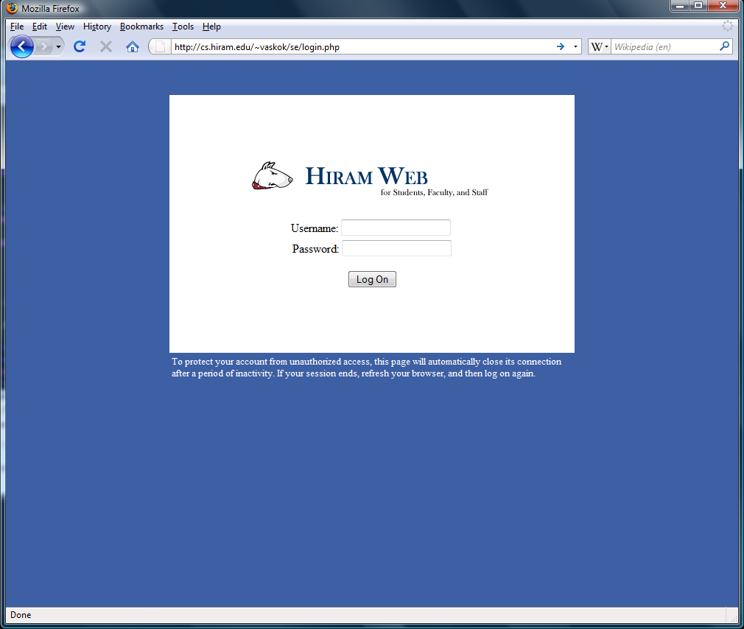
The Trap

Slide 5
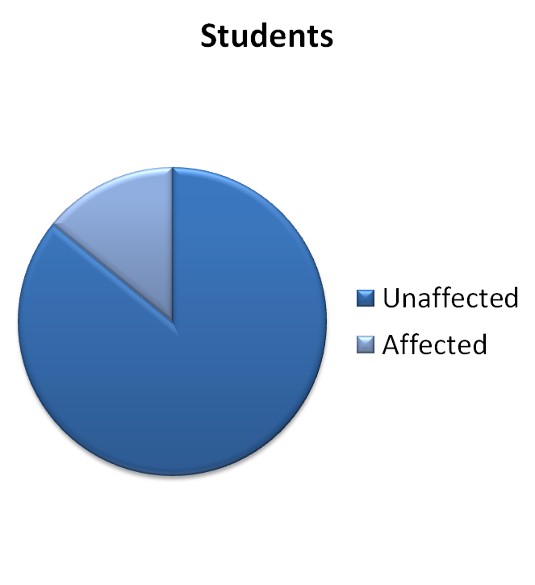

Results
14.07%
20.67%

Slide 6
Conclusions
People will reveal their passwords.
A massive pharming attack is simple and easy to execute.
The affected people are either extremely lazy or highly susceptible to panic.

Slide 7
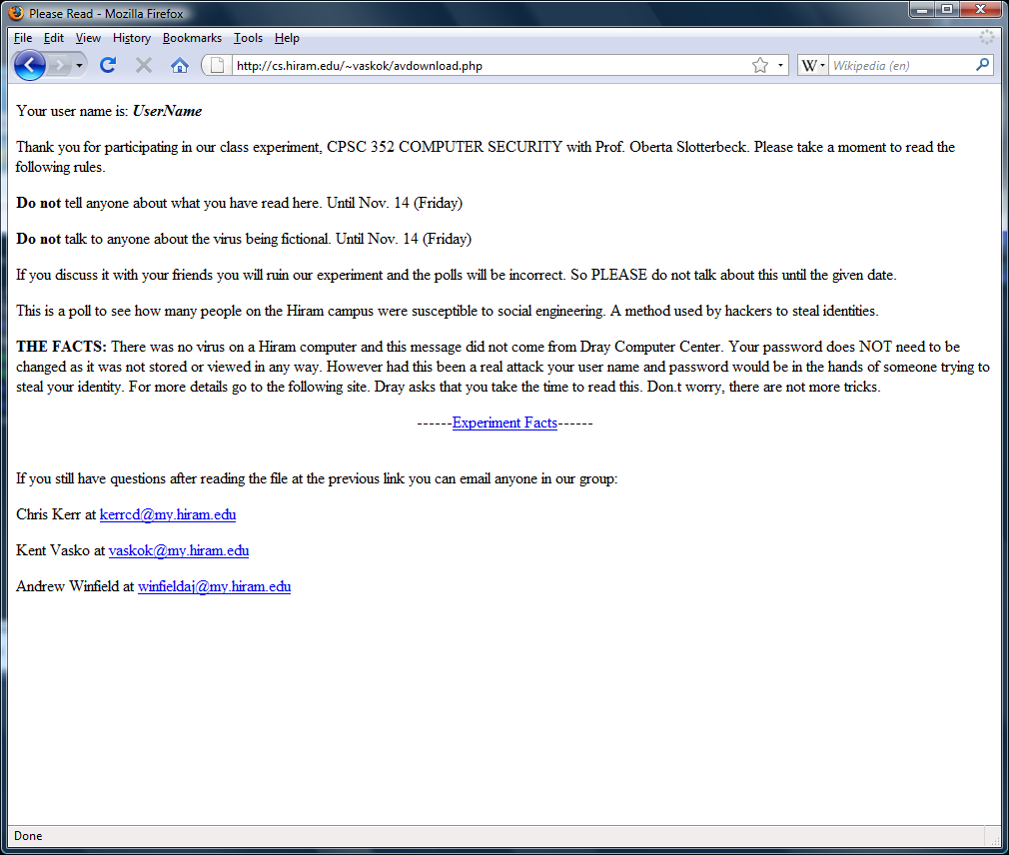
If only they took the time to read

